Slide 1
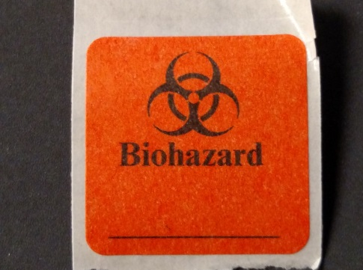
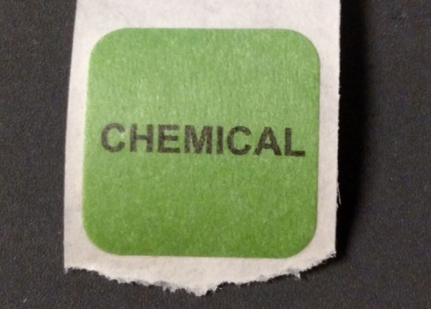
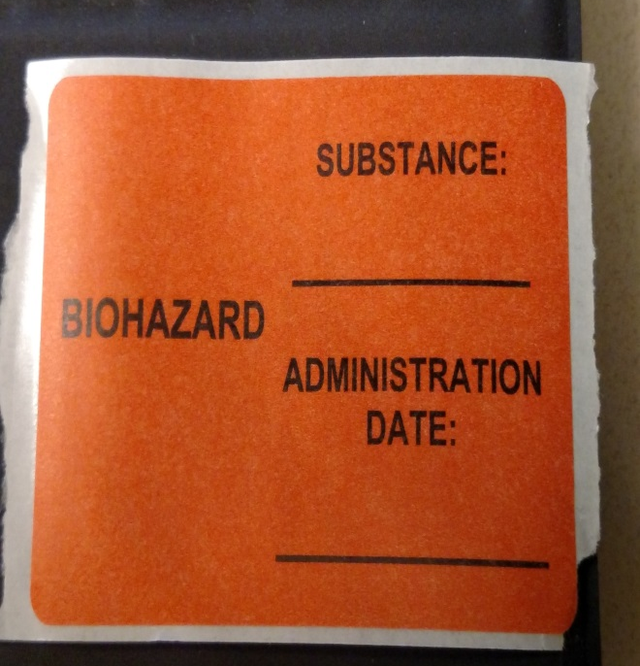
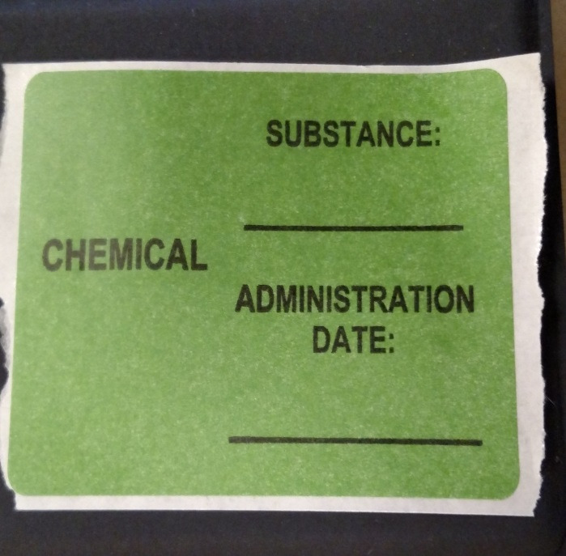
Dissolvable stickers for use on cage bottoms
Infectious/Biological Hazard Cages
Chemical Hazard Cages
Dissolvable stickers for use on water bottles containing hazardous substances
Bottles Containing Infectious/Biological Hazards
Bottles Containing Chemical Hazards

Slide 2
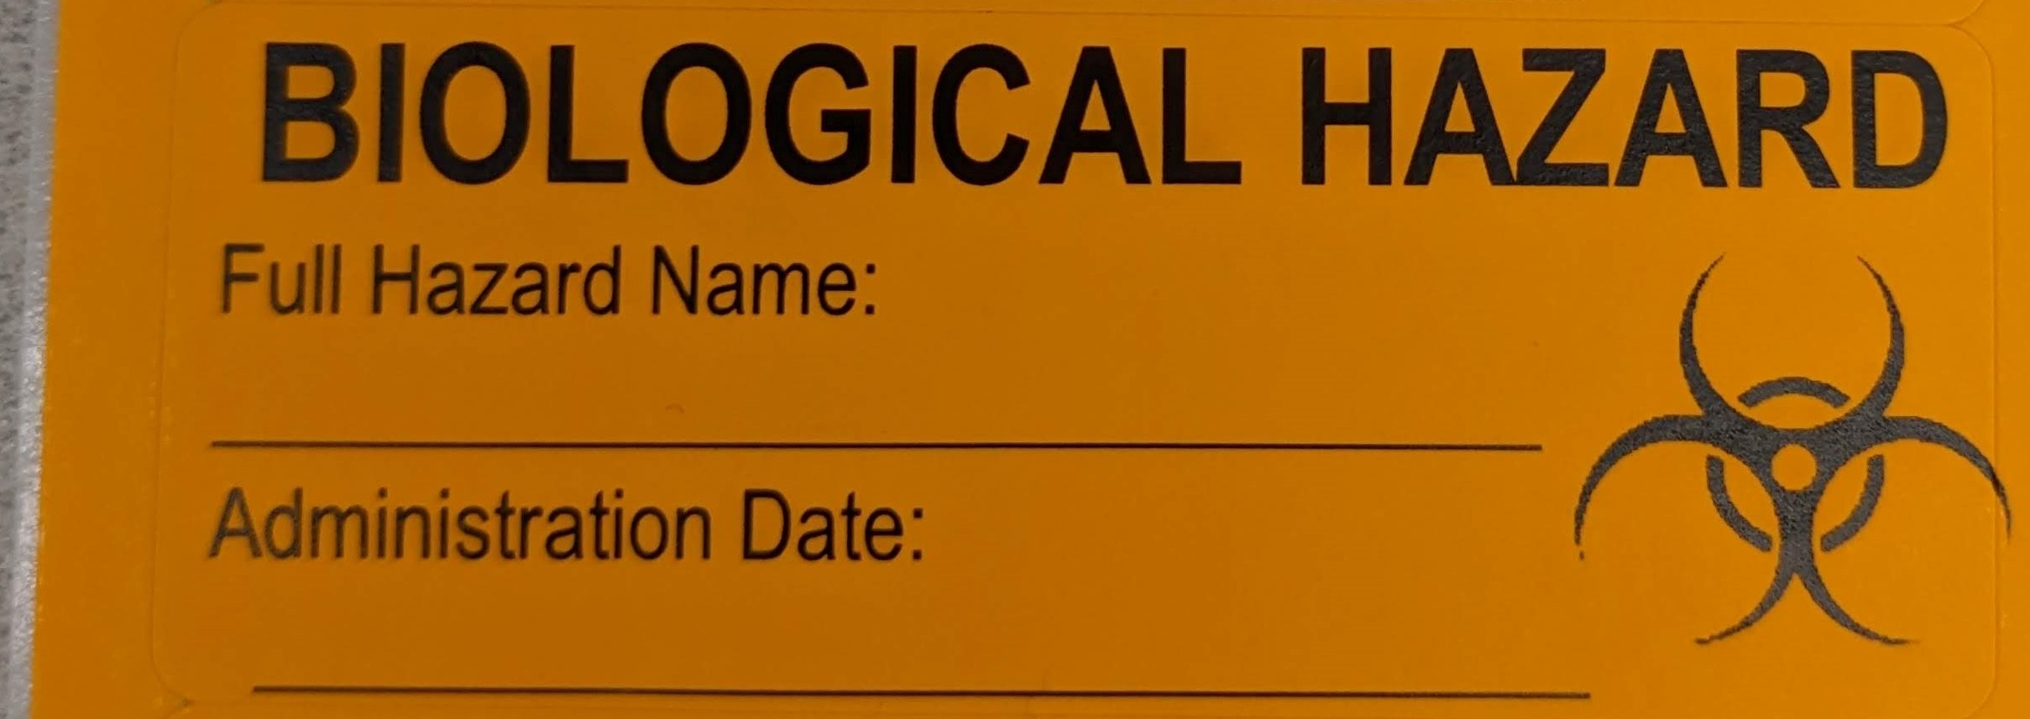
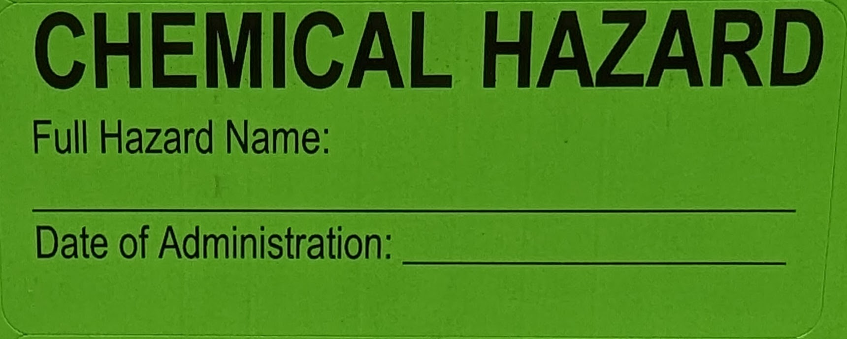
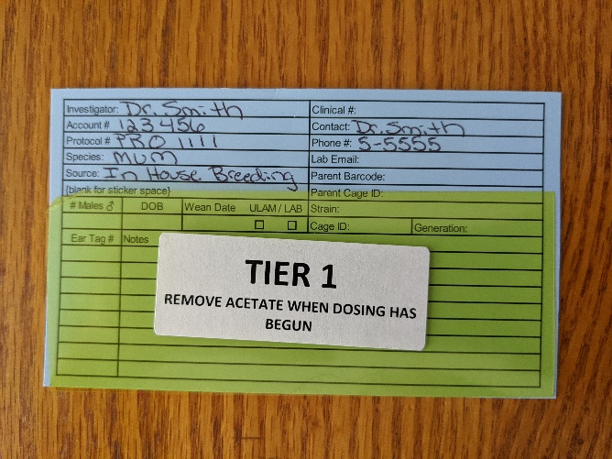
Non-dissolvable stickers for use on carcasses and with cage cards
Infectious/Biological Hazards
Chemical Hazards
Tier 1 = Naïve Animal Cage

Slide 3
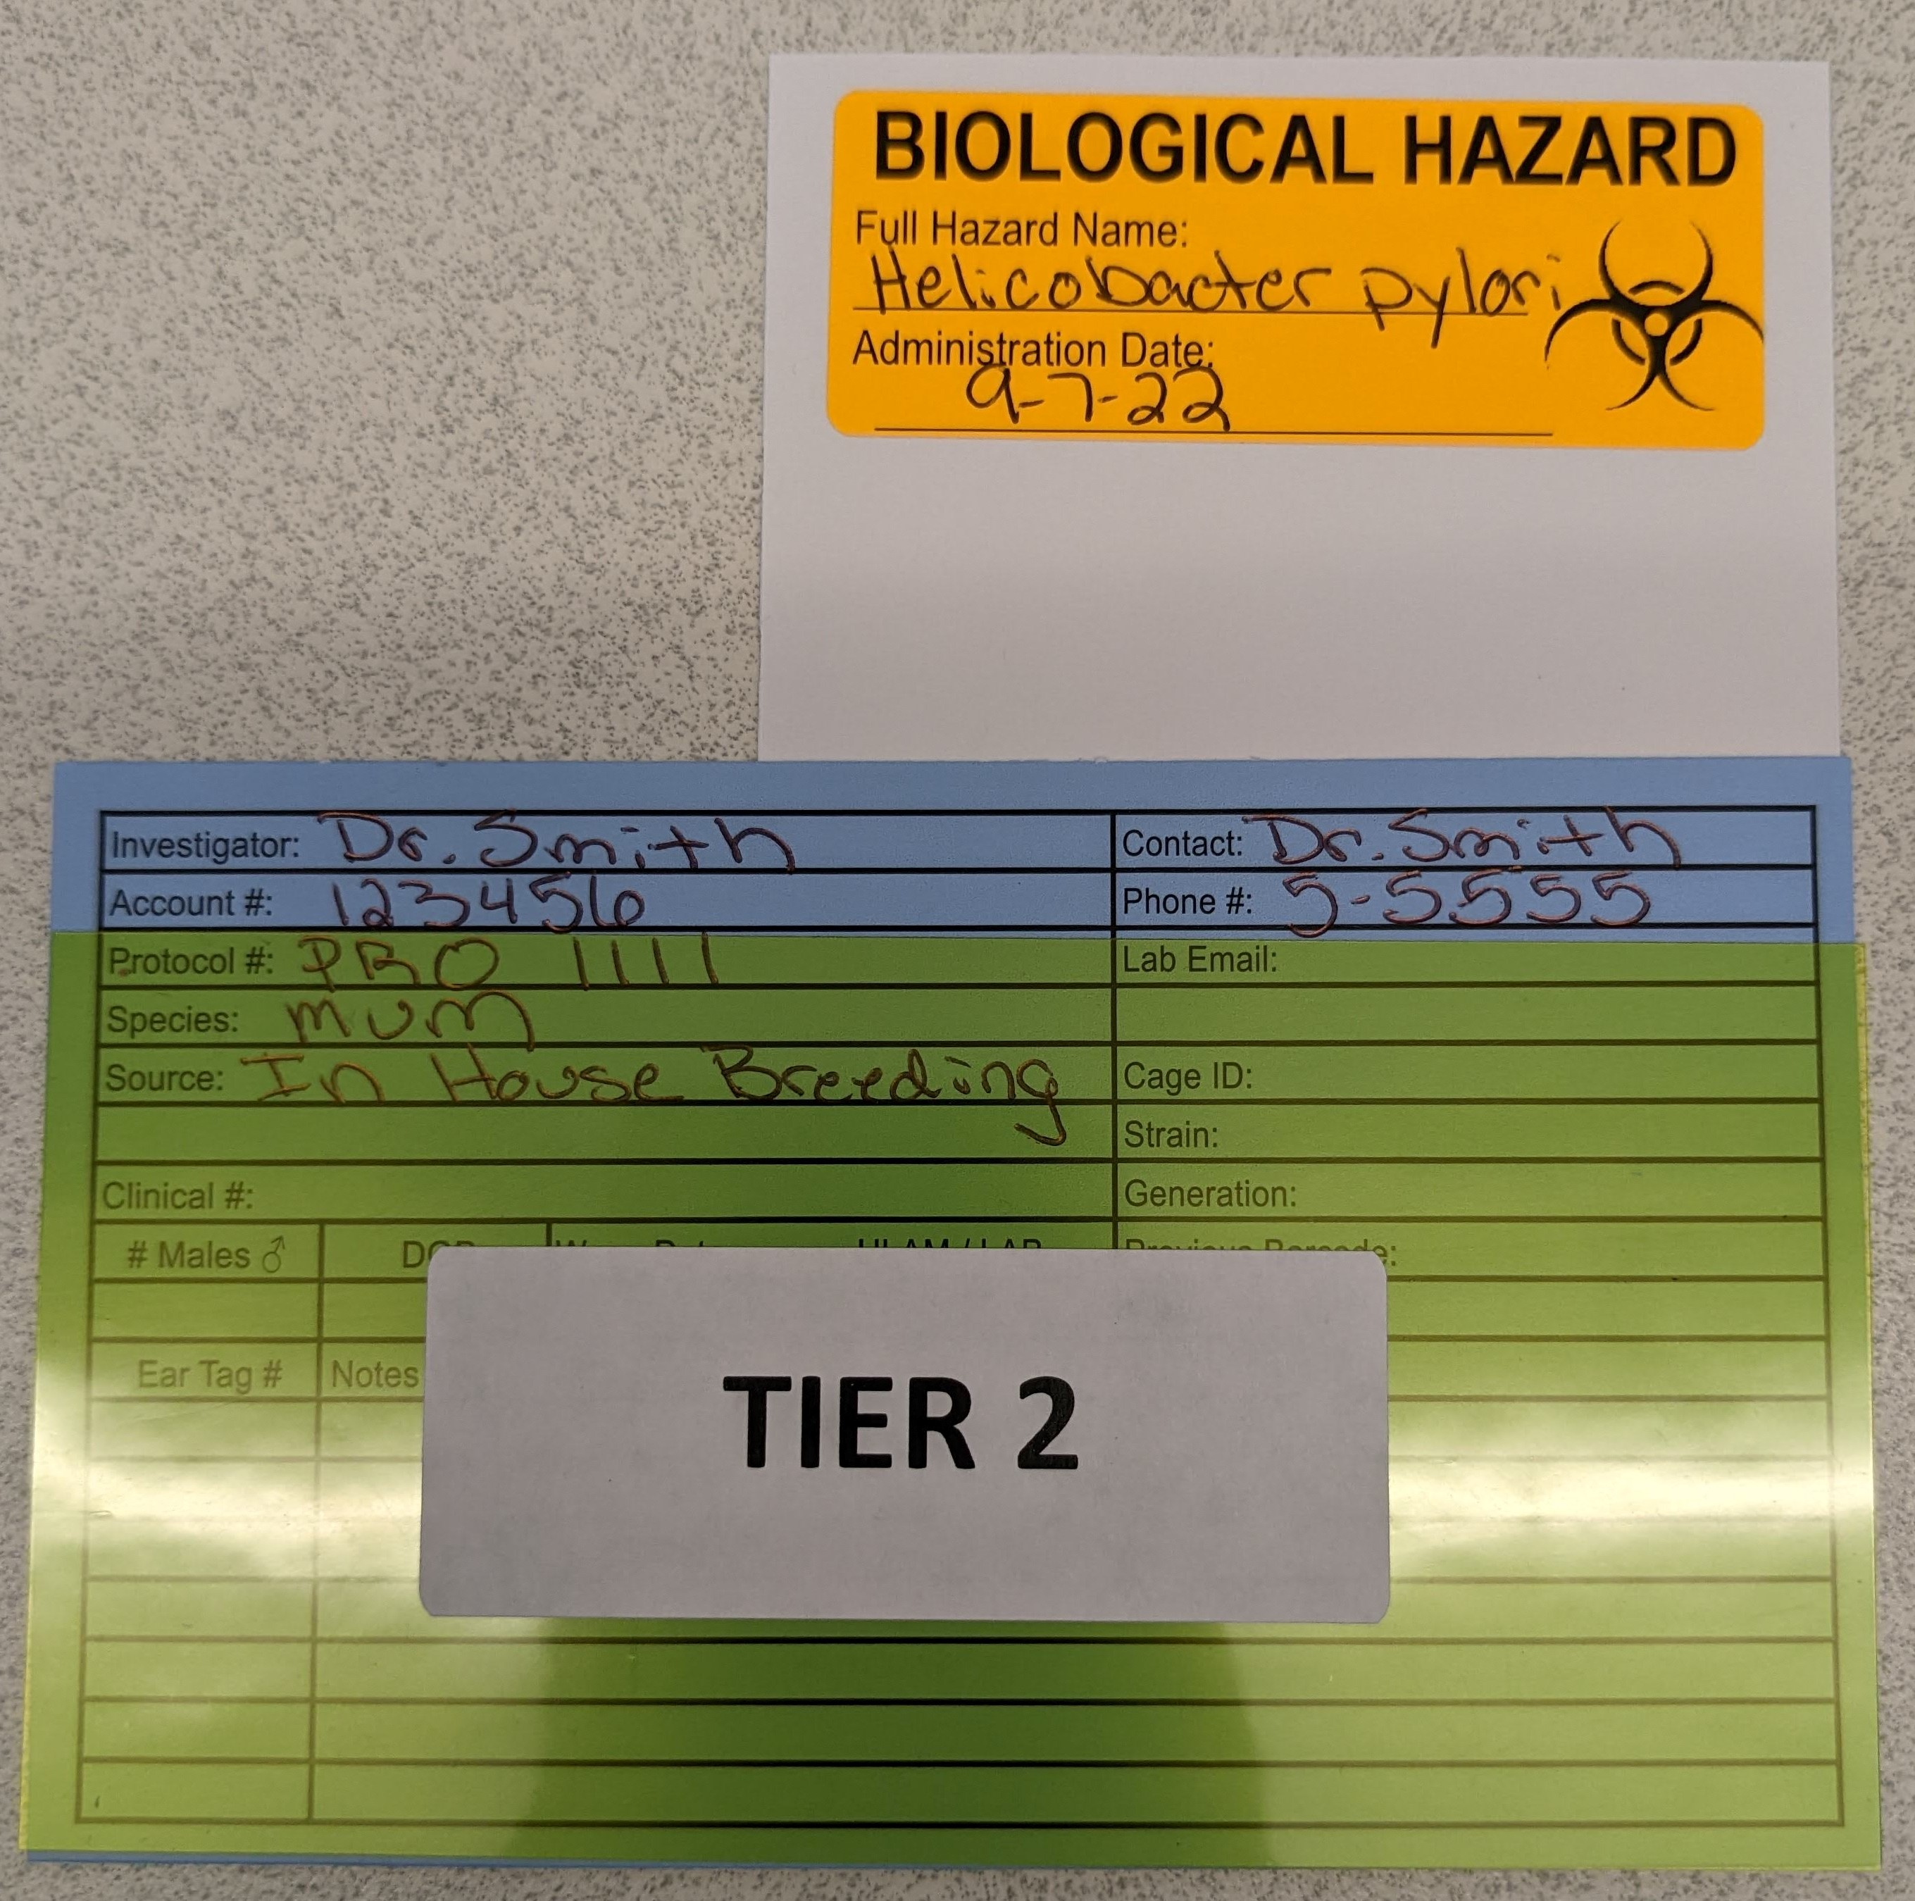
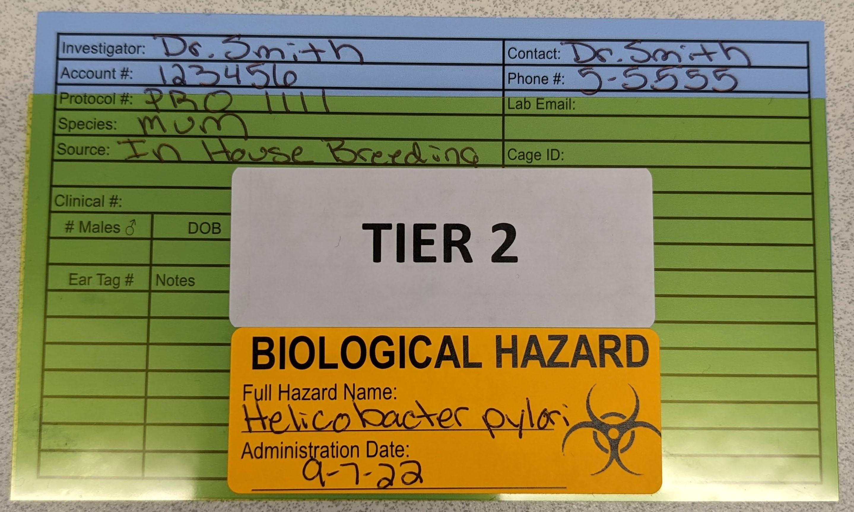
Tier 2 = Rodent infectious substances that are NOT a concern to the general colony as determined by the RHST veterinarian
Full substance name and date of administration required
Sticker on vertical cage card placed behind original cage card
Sticker on acetate

Slide 4
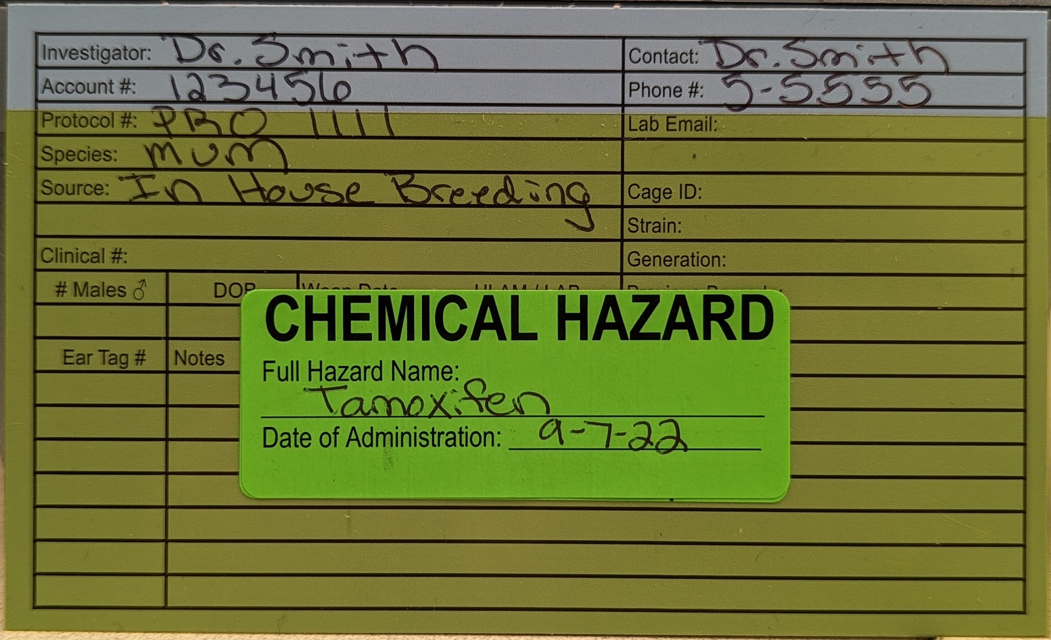
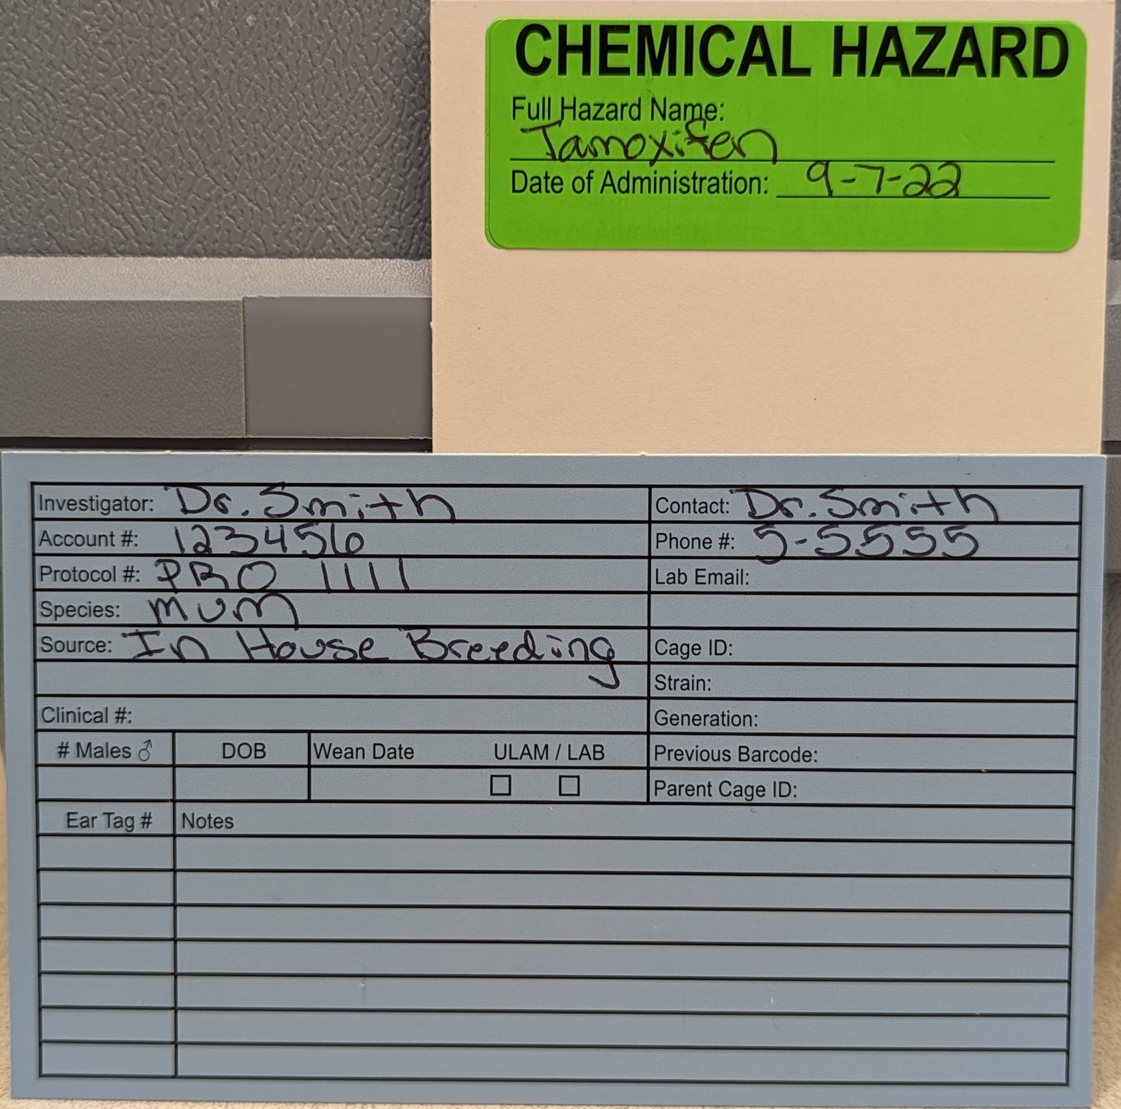
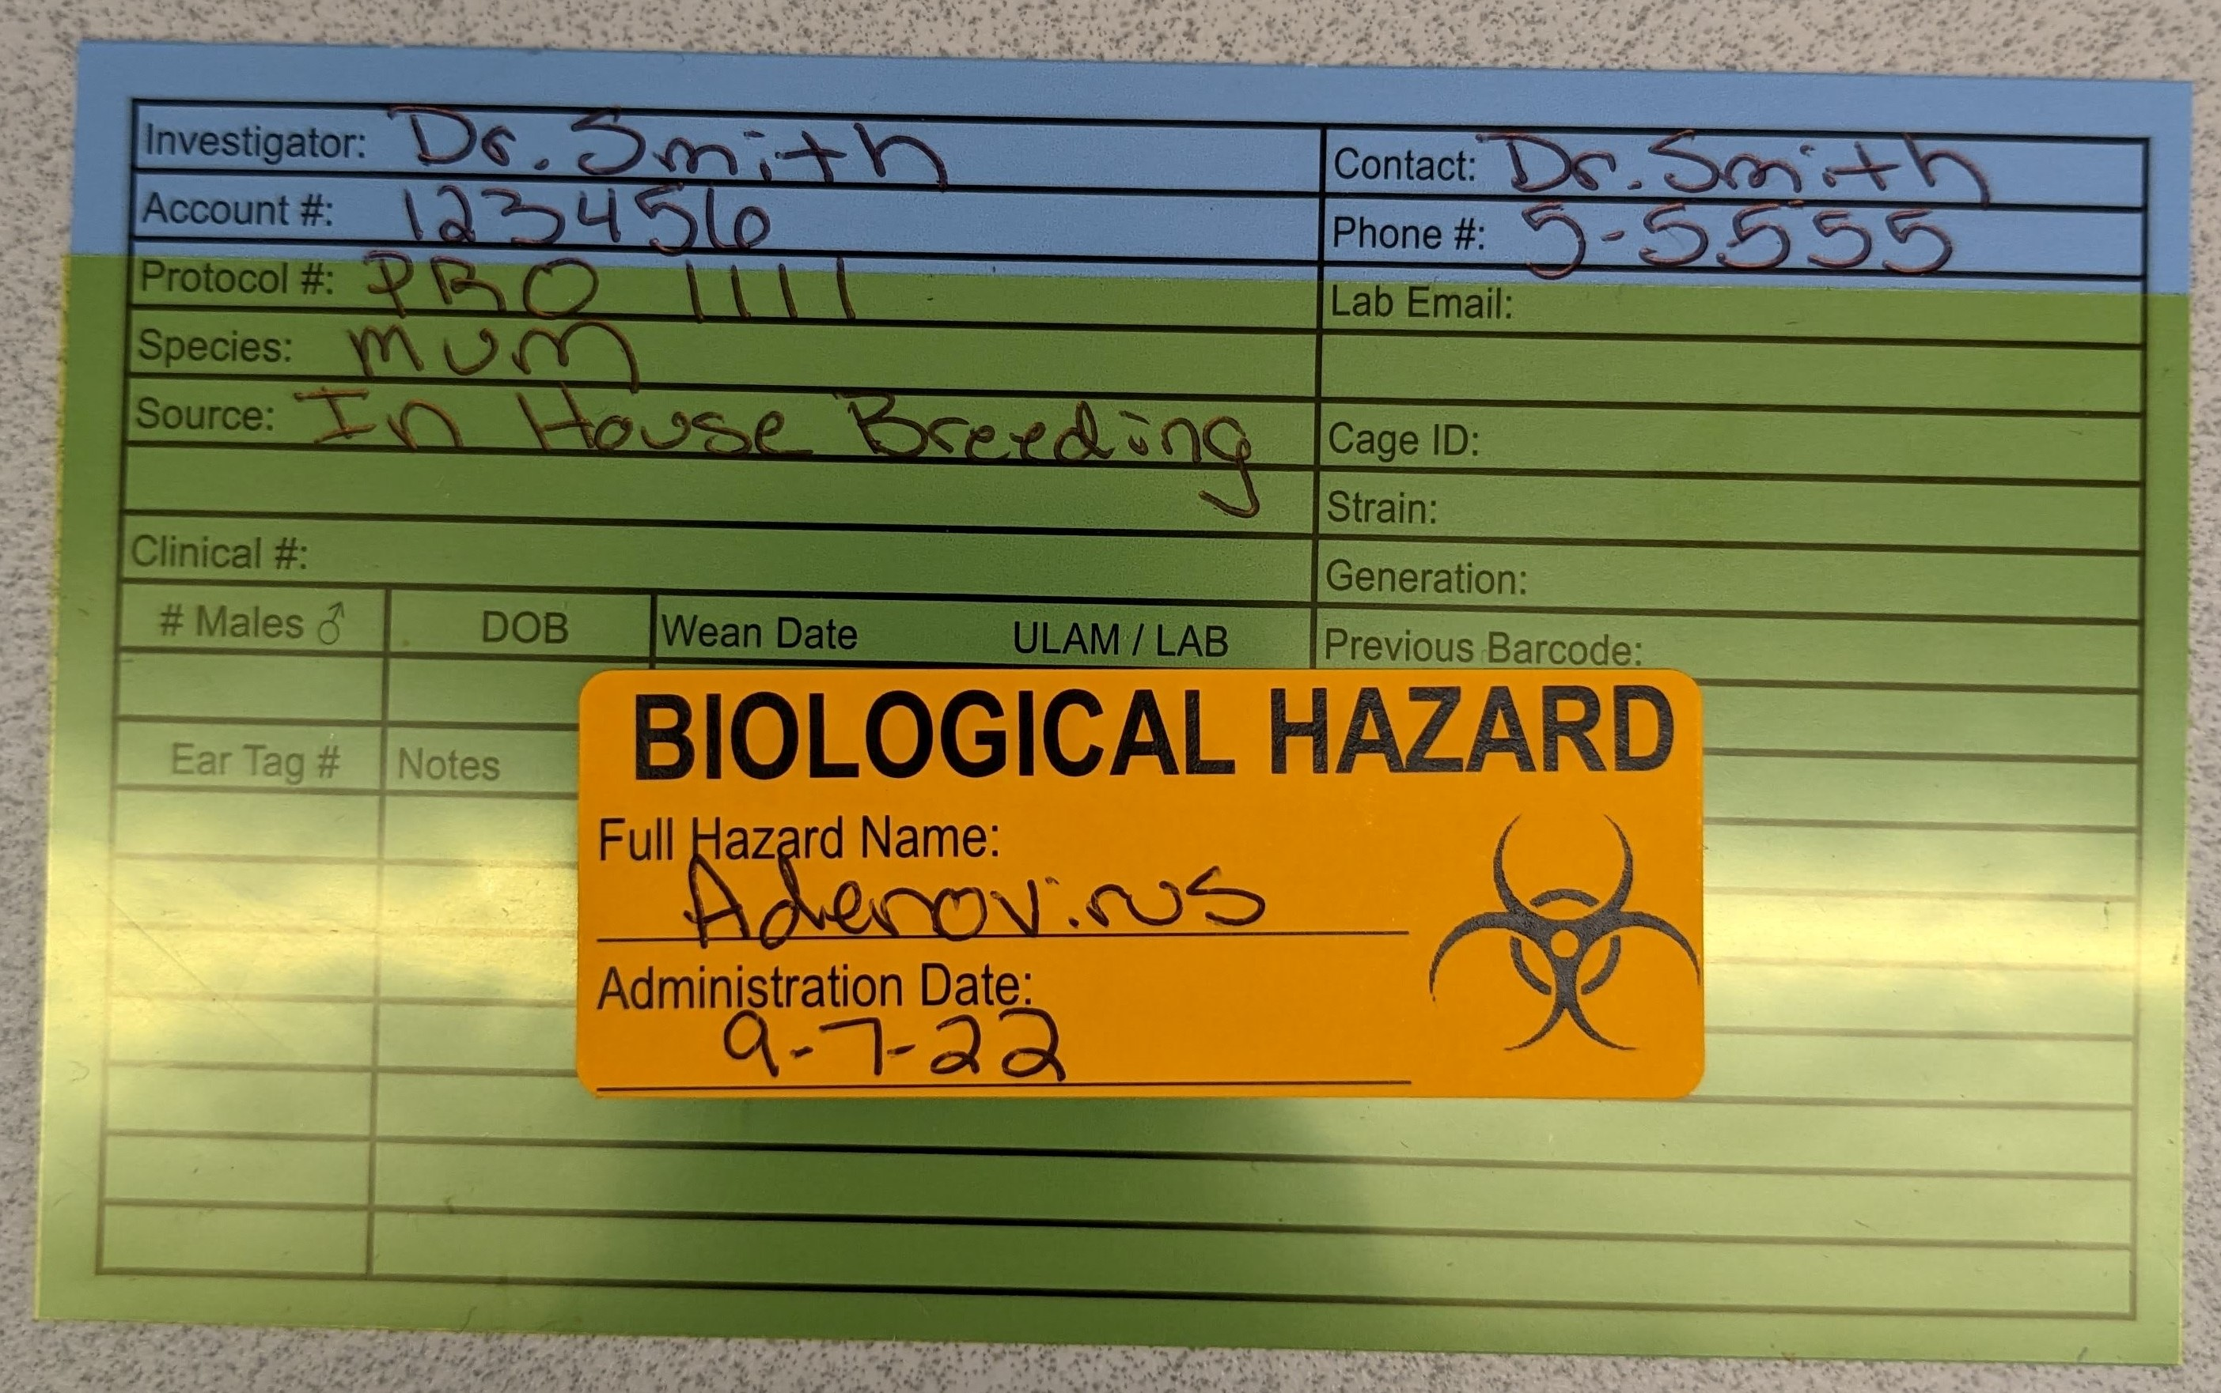
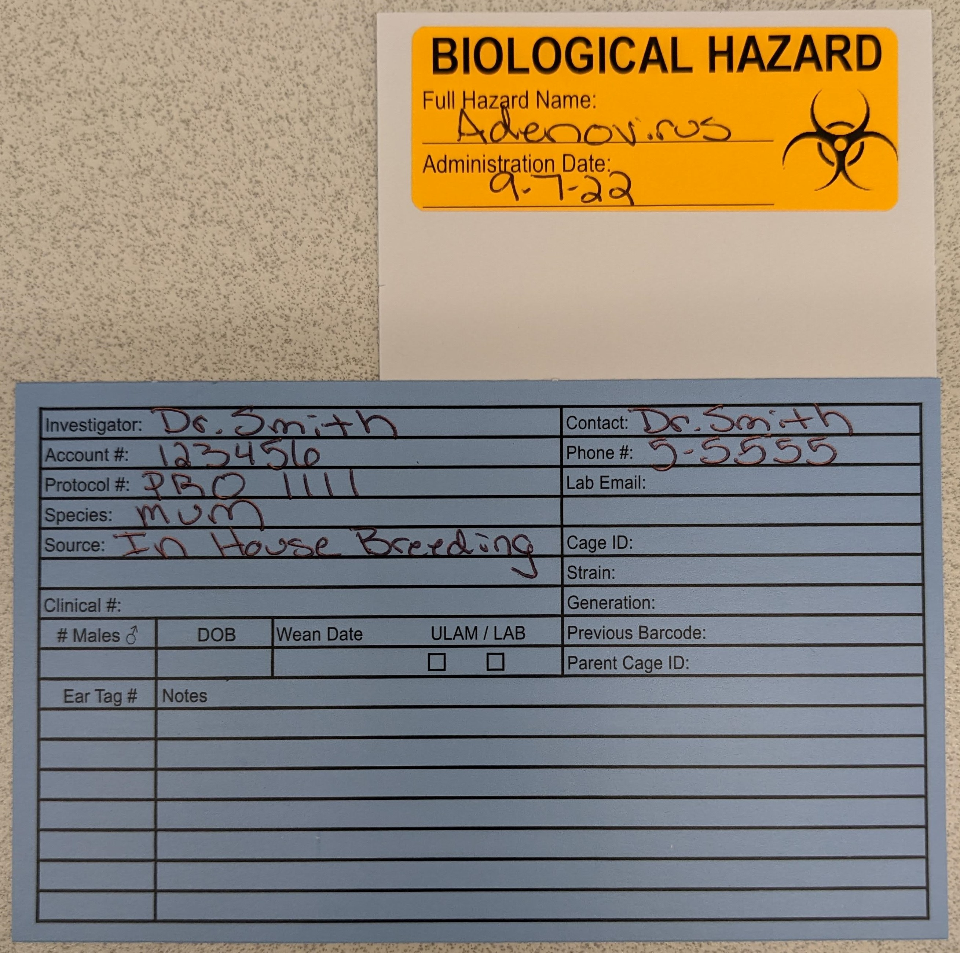
Tier 3 = Chemical hazards, human derived substances (HDS), and non-rodent infectious cages; these cages will not be acetated as Tier 3.
For chemical hazards: full substance name and date of administration is required.
Sticker on acetate
Sticker on vertical cage card placed behind original cage card
Non-rodent Infectious cages: Full substance name and date of administration is required. Note: for human derived substances, it is acceptable to abbreviate HDS on the orange infectious hazard sticker.
Sticker on acetate
Sticker on vertical cage card placed behind original cage card

Slide 5
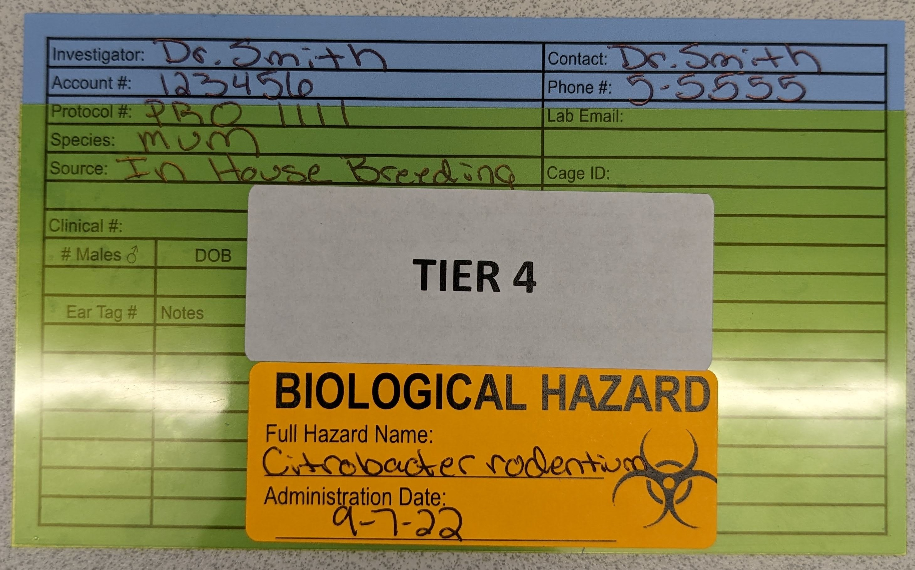
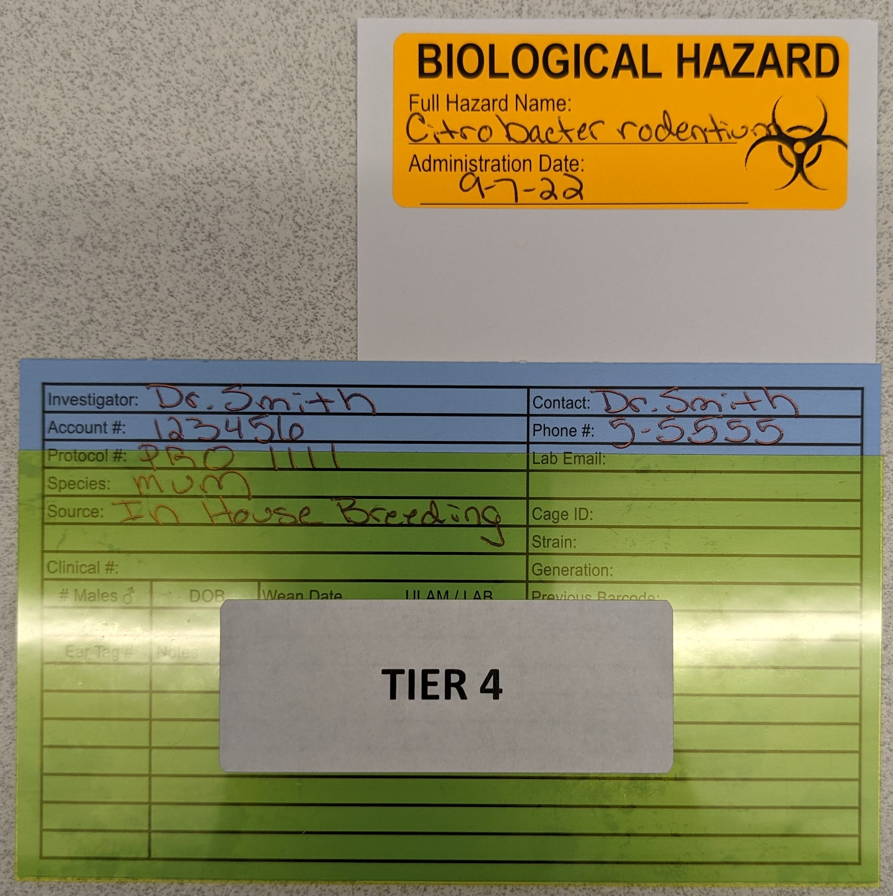
Tier 4 = Rodent infectious substances that are a concern to the general colony as determined by the RHST veterinarian
Full substance name and date of administration are required.
Sticker on vertical cage card placed behind original cage card
Sticker on acetate

